Slide 1
Causal inference in online systems: Methods, pitfalls and best practices
TUTORIAL: International conference on Computational Social Science (2016)
From Prediction to Causation
Amit Sharma
Postdoctoral Researcher, Microsoft Research
amshar@microsoft.com
@amt_shrma
http://www.github.com/amit-sharma/causal-inference-tutorial

Slide 2
Session Objectives and Takeaways
What is causal inference? Why should we care?
Most machine learning algorithms depend on correlations.
Correlations alone are a dangerous path to actionable insights.
Learn how to formulate and estimate causal effects.
To evaluate the impact of online systems.
To make underlying algorithms more robust to changes in data.
Apply causal inference methods to a practical problem
Estimating the causal impact of a recommendation system.

Slide 3
I. We have increasing amounts of data and highly accurate predictions. How is causal inference useful?

Slide 4
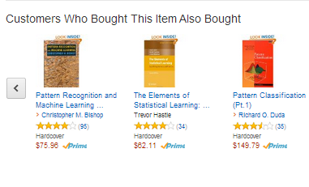
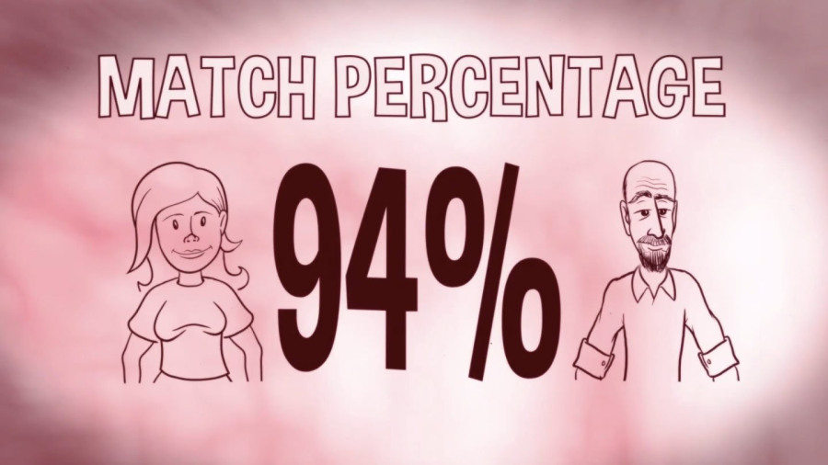
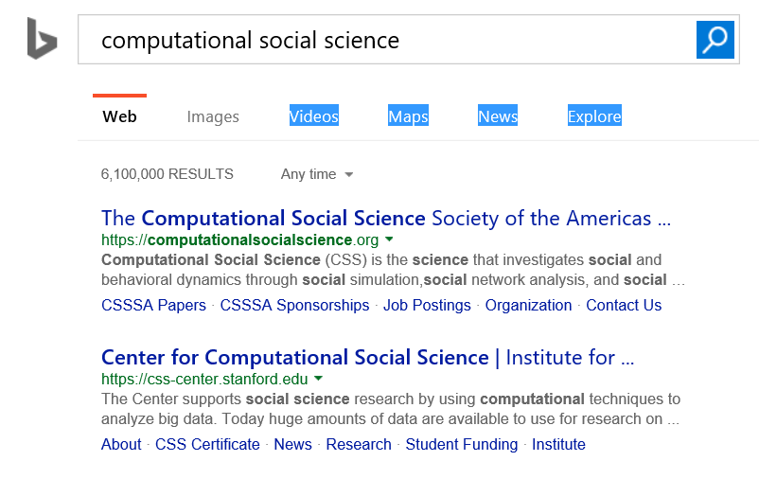

Predictive systems are everywhere

Slide 5


How do predictive systems work?
Aim: Predict future activity for a user.
We see data about their user profile and past activity.
E.g., for any user, we might see their age, gender, past activity and their social network.
…

Slide 6
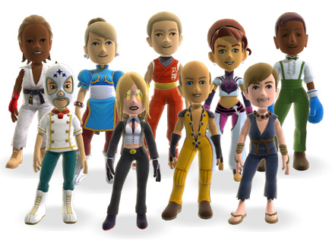
From data to prediction
Higher Activity Lower Activity
✗
Use these correlations to make a predictive model.
Future Activity ->
f(number of friends, logins in past month)

Slide 7
From data to “actionable insights”
Number of friends can predict activity with high accuracy.
How do we increase activity of users?
Would increasing the number of friends increase people’s activity on our system?
Maybe, may be not (!)

Slide 8
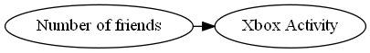
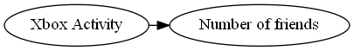
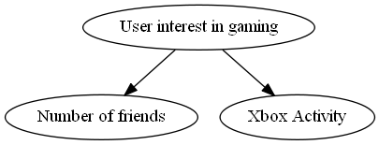
Different explanations are possible
How do we know
what causes what?
Decision: To increase activity, would it make sense to launch a campaign to increase friends?

Slide 9


Another example: Search Ads
Search engines uses ad targeting to show relevant ads.
Prediction model based on user’s search query.
Search Ads have the highest click-through rate (CTR) in online ads.

Slide 10
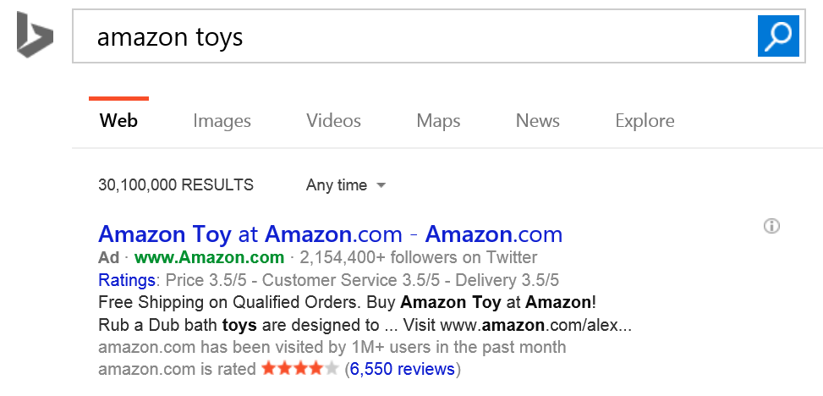
Are search ads really that effective?
Ad targeting was highly accurate.
Blake-Tadelis-Noskos (2014)

Slide 11
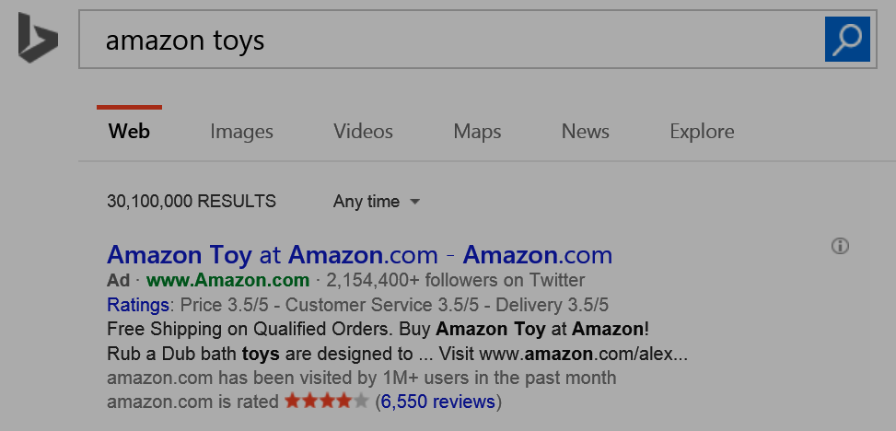
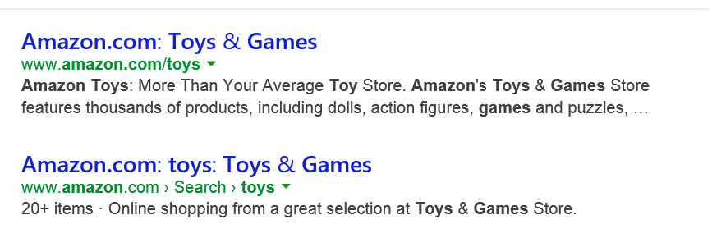
But search results point to the same website
Counterfactual question: Would I have reached Amazon.com anyways, without the ad?

Slide 12
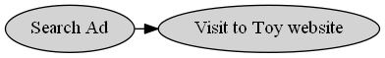
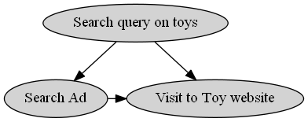
Without reasoning about causality, may overestimate effectiveness of ads
x% of ads shown are effective
<x% of ads shown are effective

Slide 13
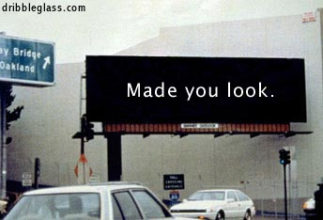
Okay, search ads have an explicit intent. Display ads should be fine?
Probably not.
There can be many hidden causes for an action, some of which may be hard to quantify.

Slide 14


Estimating the impact of ads
Toys R Us designs new ads.
Big jump in clicks to their ads compared to past campaigns. Were these ads more effective?

Slide 15
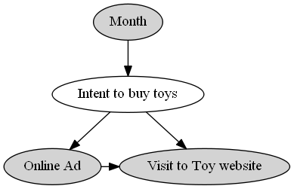
People anyways buy more toys in December
Misleading to compare ad campaigns with changing underlying demand.

Slide 16
So far, so good. Be mindful of hidden causes, or else we might overestimate causal effects.

Slide 17
(But) Ignoring hidden causes can also lead to completely wrong conclusions.

Slide 18

Example: Which algorithm is better?
Have a current production algorithm. Want to test if a new algorithm is better.
Say recommendations on app store.
?
Algorithm A
Algorithm B

Slide 19
Comparing old versus new algorithm
Two algorithms, A (production) and B (new) running on the system.
From system logs, collect data for 1000 sessions for each. Measure CTR.
Old Algorithm (A) | New Algorithm (B)
50/1000 (5%) | 54/1000 (5.4%)
New algorithm is better?

Slide 20
Frequent users of the Store tend to be different from new users
So let us look at
CTR separately.
Old Algorithm (A) | New Algorithm (B)
10/400 (2.5%) | 4/200 (2%)
Low-activity Users
Old Algorithm (A) | New Algorithm (B)
40/600 (6.6%) | 50/800 (6.2%)
High-activity Users

Slide 21
The Simpson’s paradox
 | Old algorithm (A) | New Algorithm (B)
CTR for Low-Activity users | 10/400 (2.5%) | 4/200 (2%)
CTR for High-Activity users | 40/600 (6.6%) | 50/800 (6.2%)
Total CTR | 50/1000 (5%) | 54/1000 (5.4%)
Is Algorithm A better?
Simpson (1951)

Slide 22
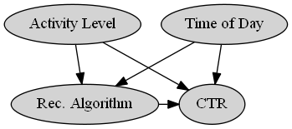
Answer (as usual): May be, may be not.
E.g., Algorithm A could have been shown at different times than B.
There could be other hidden causal variations.

Slide 23
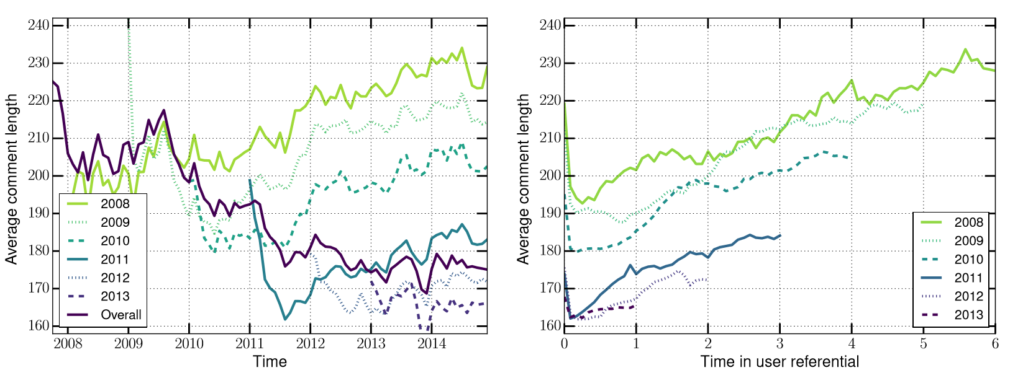
Example: Simpson’s paradox in Reddit
Average comment length decreases over time.
But for each yearly cohort of users, comment length increases over time.
Barbosa-Cosley-Sharma-Cesar (2016)

Slide 24

Making sense of such data can be too complex.

Slide 25
II. How do we systematically reason about and estimate the relationship between effects and their causes?

Slide 26
Formulating causal inference problems
Causal inference: Principled basis for both experimental and non-experimental methods.
Aside: Such questions form the basis of almost all scientific inquiry.
E.g., occur in medicine (drug trials, effect of a drug), social sciences (effect of a certain policy), and genetics (effect of genes on disease).
Frameworks:
Causal graphical models [Pearl 2009]
Potential Outcomes Framework [Imbens-Rubin 2016]

Slide 27
What does it mean to cause?
A big philosophical debate (since the times of Aristotle, Hume and others).
Practical meaning*: X causes Y iff
changing X leads to a change in Y,
keeping everything else constant.
The causal effect is the magnitude by which Y is changed by a unit change in X.
*Interventionist definition [http://plato.stanford.edu/entries/causation-mani/]

Slide 28
Need answers to “what if” questions
Basic construct of causal inference.
Counterfactual thinking*:
What would have happened if I had changed X?
E.g. What would have been the CTR had we not shifted to the new algorithm?
*Counterfactual theories of causation
http://plato.stanford.edu/entries/causation-counterfactual/

Slide 29





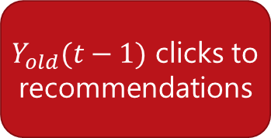
Why is it hard?
Naïve estimate
$$Y_{new}(t)−Y_{old}(t−1)$$
Old Algorithm
$Y_{old}(t−1)$ clicks to recommendations
Causal estimate
$$Y_{new}(t)−Y_{old}(t)$$
New Algorithm
Old Algorithm
$Y_{new}(t)$ clicks to recommendations
$Y_{old}(t)$ clicks to recommendations
Cloned user
Ideally, requires creation of multiple worlds.

Slide 30
Methods for answering causal questions
Randomization
A/B test
Multi-armed bandits
Natural Experiments
Regression discontinuity
Instrumental Variables
Conditioning
Stratification, Matching
Propensity Scores
VALIDITY
EASE OF USE

Slide 31
IIa. Randomization to the rescue

Slide 32
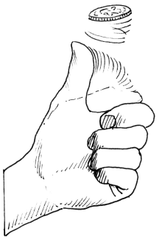
Randomizing algorithm assignment: A/B test
We cannot clone users.
Next best alternative: Randomly assign which users see new Algorithm’s recommendations and which see the old algorithm’s.

Slide 33




Randomization removes hidden variation
Old Algorithm
$Y_{old}(t−1)$ clicks to recommendations
…
Causal estimate
$$Y_{new}(t)−Y_{old}(t)$$
New Algorithm
Old Algorithm
$Y_{new}(t)$ clicks to recommendations
$Y_{old}(t)$ clicks to recommendations
Random User 1
Random User 2

Slide 34
Cost: Possibly bad user experience for many users
Say the new algorithm was really bad.
Can decrease the percentage of users who see the new algorithm, but how do we know this beforehand?
Such manual tweaks even more inefficient if multiple algorithms to test.

Slide 35

Efficient randomization: Multi-armed bandits
Two goals:
Show the best known algorithm to most users.
Keep randomizing to update knowledge about competing algorithms.

Slide 36



Bandits: The right mix of explore and exploit
Old Algorithm
$Y_{old}(t−1)$ clicks to recommendations
…
Current-best Algorithm
Random Algorithm
$Y_{new}(t)$ clicks to recommendations
$Y_{rand}(t)$ clicks to recommendations
Most users
Other users

Slide 37
Algorithm: ɛ-greedy multi-armed bandits
Repeat:
(Explore) With low probability ɛ, choose an output item randomly.
(Exploit) Otherwise, show the current-best algorithm.
Use CTR results for Random output items to train new algorithms offline.

Slide 38
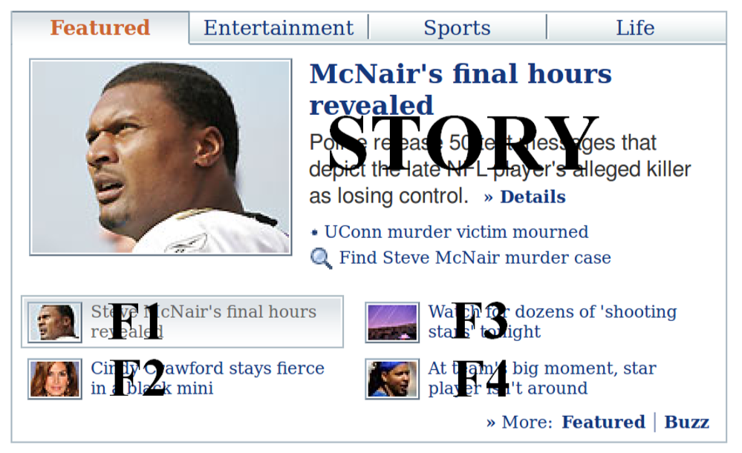
Practical Example: Contextual bandits on Yahoo! News
Actions: Different news articles to display
A/B tests using all articles inefficient.
Randomize the articles shown using ɛ-greedy policy.
Better: Use context of visit (user, browser, time, etc.) to have different current-best algorithms for different contexts.
Li-Chu-Langford-Schapire (2010)

Slide 39
Caveat: Not always feasible to randomize, or ensure that people fully comply
Randomization may be too expensive or involve ethical hazards.
There may not be perfect compliance with random assignment. E.g. referral experiment for a subscription service like Netflix.
Even when feasible, randomization methods need a limited set of "good" alternatives to test.
How do we identify a good set of algorithms or a good set of parameters?
Common metrics like CTR will not be useful, because they might miss hidden causes.
Need causal metrics.

Slide 40
IIb. So how about naturally occurring experiments?

Slide 41
“Natural” experiments: exploit variation in observed data
Can exploit naturally occurring close-to-random variation in data.
Since data is not randomized, need assumptions about the data-generating process.
If there is sufficient reason to believe the assumptions, we can estimate causal effects.
Dunning (2002), Rosenzweig-Wolpin (2000)

Slide 42
Example: Effect of Store recommendations
Suppose instead of comparing recommendation algorithms, we want to estimate the causal effect of showing any algorithmic recommendation.
Can be used to benchmark how much revenue a recommendation system brings, and allocate resources accordingly.
(and perhaps help analyze the tradeoff with users’ privacy)

Slide 43

Exploiting arbitrary cutoffs to recommendations
Only 3 recommendations shown to user.

Slide 44

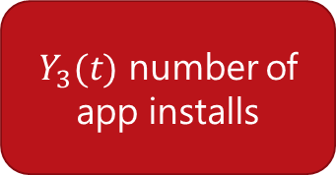
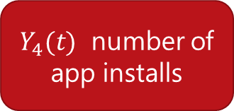
Assumption: Closely-ranked not-shown apps are as relevant as shown apps
Causal effect of being shown as recommendation
$$Y_{3}(t)−Y_{4}(t)$$
3rd ranked app (Shown)
4th ranked app
(Not-shown)
$Y_{3}(t)$ number of app installs
$Y_{4}(t)$ number of app installs
Same user

Slide 45
Algorithm: Regression discontinuity
For any top-k recommendation list:
Using logs, identify apps that were similarly ranked but could not make it to the top-k shown apps.
Measure difference in app installs between shown and not-shown apps for each user.
Imbens-Lemieux (2008)

Slide 46
Another natural experiment: Instrumental Variables
Can look at as-if random variations due to external events.
E.g. Featuring on the Today show may lead to a sudden spike in installs for an app.
Such external shocks can be used to determine causal effects, such as the effect of showing recommendations.
Angrist-Pischke (2008)

Slide 47
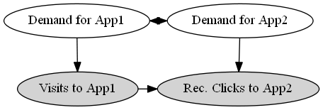

Cont. example: Effect of store recommendations
How many new visits are caused by the recommender system?
Demand for App 1 is correlated with demand for App 2.
$⇒$ Users would most likely have visited App 2 even without recommendations.

Slide 48

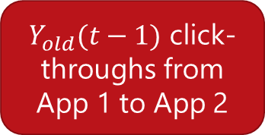
Traffic on normal days to App 1
$Y_{old}(t−1)$ click-throughs from
App 1 to App 2
Cannot say much about the causal effect of recommendations from App 1.
$Y_{new}(t)$ click-throughs from
App 1 to App 2

Slide 49


External shock brings as-if random users to App1
$Y_{old}(t−1)$ click-throughs from
App 1 to App 2
Spike in visits to App 1
If demand for App 2 remains constant, additional views to App 2 would not have happened had these new users not visited App 1.
$$Causal clicks =Y_{new}^{′}\left(t\right)−Y_{old}(t−1)$$
$Y_{new}^{′}(t)$ click-throughs from
App 1 to App 2
Sharma-Hofman-Watts (2015)

Slide 50
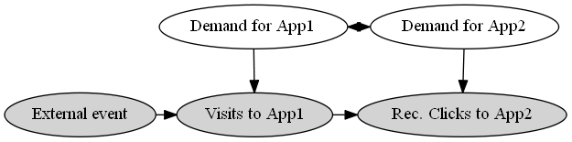

Exploiting sudden variation in traffic to App 1
To compute Causal CTR of Visits to App1 on Visits to App2:
Compare observed effect of external event separately on Visits to App1, and on Rec. Clicks to App2.
Causal click-through rate =$\frac{\text{Δ}\text{(}\text{Rec}\text{. }\text{Click}\text{−}\text{throughs} \text{from} \text{App}\text{1 }\text{to} \text{App}\text{2)}}{\text{Δ}\text{(}\text{Visits} \text{to} \text{App}\text{1)}}$

Slide 51
Caveat: Natural experiments are hard to find
Estimates may not be generalizable to all products.
Critical assumptions may not be satisfied.
Both sources of experimentation:
Controlled
Natural
ruled out.
Can we estimate causal effects with only observational data?

Slide 52
IIc. What can we conclude with only observed data?

Slide 53
Imagine a randomized experiment…
Old Algorithm
$Y_{old}(t−1)$ clicks to recommendations
…
New Algorithm
Old Algorithm
$Y_{new}(t)$ clicks to recommendations
$Y_{old}(t)$ clicks to recommendations
Random User 1
Random User 2

Slide 54

Compare with a similar user instead of random
Old Algorithm
$Y_{old}(t−1)$ clicks to recommendations
…
Causal estimate
$≈ Y_{new}(t)−Y_{old}(t)$
New Algorithm
Old Algorithm
$Y_{new}(t)$ clicks to recommendations
$Y_{old}(t)$ clicks to recommendations
User 1
Similar User 2

Slide 55
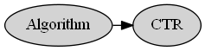
Continuing example: Effect of Algorithm on CTR
Make assumptions about how the data as generated.
Create a graphical model representing those assumptions.
Does new Algorithm B increase CTR for recommendations on Windows Store, compared to old algorithm A?

Slide 56
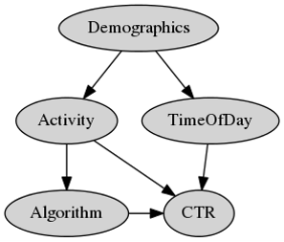
Previous example: Effect of Algorithm over CTR
Does new Algorithm B increase CTR for recommendations on Windows Store, compared to old algorithm A?
Make assumptions about how the data as generated.
Create a graphical model representing those assumptions.

Slide 57

Assumptions to estimate effect of Algorithm
$Activity$ level of users affects which $Algorithm$ they are shown and their overall $CTR$.
$CTR$ is different at different times of day.
Unobserved $Demographics$ of a user determine when they visit the Store, which also affects their $Activity$ level, and in turn the $Algorithm$ they are shown.

Slide 58

General method: Conditioning on variables
Intuition: Compare effect of algorithm on similar users.
$⇒$Compare users with the same activity level.
Steps:
Stratify log data based on activity levels.
Compare CTR of different algorithms within these strata.

Slide 59
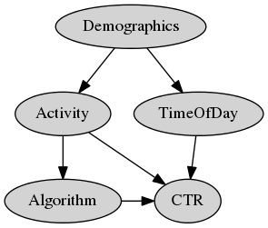

Should we also restrict our comparison to people who come at the same times?
$CTR$ does depend on $Time of Day$ of a user’s visit.
But the algorithm assigned does not change based on $Time of Day$.
$⇒$ While $CTR$ may be different at different times, any $Algorithm$ is equally likely to be shown at any point in time.

Slide 60
Tricky to find correct variables to condition on. Fortunately, graphical models make it precise.
Backdoor paths: Look for (undirected) paths that point to both $Algorithm$ and $CTR$.
Pearl (2009)

Slide 61
Backdoor criterion: Condition on enough variables to cover all backdoor paths

Slide 62
Algorithm: Stratification
With observational data:
Assume a graphical model that explains how the data was generated.
Choose variables to condition on using backdoor criterion.
Stratify data into subsamples such that each subsample has the same value of all conditioned variables.
Evaluate the difference in outcome variable separately within these strata.
(Optional) Aggregate over all data.

Slide 63
Stratification may be inefficient if there are multiple hidden causes
Stratification creates tiny strata when data is high-dimensional. Hard to obtain stable estimates.
E.g. activity data may be high-dimensional: a vector for purchases in each app category.
Key Idea: Instead of conditioning on all relevant attributes, can condition on the likelihood of being assigned an Algorithm.
Morgan-Winship (2014)

Slide 64
This was stratification…
Old Algorithm
$Y_{old}(t−1)$ clicks to recommendations
User 2 and User 1 are the same on all relevant attributes.
…
New Algorithm
Old Algorithm
$Y_{new}(t)$ clicks to recommendations
$Y_{old}(t)$ clicks to recommendations
User 1
Similar User 2

Slide 65
Instead condition on propensity to new Algorithm
Old Algorithm
$Y_{old}(t−1)$ clicks to recommendations
User 2 and User 1 are equally likely to be shown New Algorithm.
…
New Algorithm
Old Algorithm
$Y_{new}(t)$ clicks to recommendations
$Y_{old}(t)$ clicks to recommendations
User 1
Similar User 2

Slide 66


Continued example: Effect of Algorithm on CTR
Based on backdoor criterion, need to condition only on Activity.
Activity is multi-dimensional.
$$Activity=(a_{cat1}, a_{cat2}, …a_{catn})$$
Estimate likelihood to be shown New Algorithm using observed Algorithm-user pairs.
$$Propensity_{NewAlgo}\left(User_{i}\right)=Logistic(a_{cat1}, a_{cat2}, …a_{catn})$$
Compare CTR between users with the same propensity score.

Slide 67
Algorithm: Propensity score matching
With observational data:
Assume a graphical model that explains how the data was generated.
Choose variables to condition on using backdoor criterion.
Compute propensity score for each user based on conditioned variables.
Match pairs of individuals with similar scores, where one of them saw Old Algorithm and the other saw New Algorithm.
Compare the outcome variable within each such matched pair and aggregate.
Morgan-Winship (2014)

Slide 68
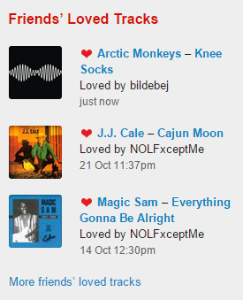
Example: Causal effect of a social news feed
Friends on a social network may Like similar items
E.g. on Last.fm, friends of a user may like similar music to the user
This may be due to influence, or
simply due to homophily
Causal question: Given only
log data, how can we determine
social influence due to the newsfeed,
compared to homophily effects?

Slide 69
Example: Causal effect of a social newsfeed
Solution: Use matching based on past items liked by each user, to create control group of non-friends that are as similar to a user as her friends.
f5
n5
f1
n1
u
f4
u
n4
f2
f3
n2
n3
Ego Network
Non-Friends
Sharma-Cosley (2015), Aral-Muchnik-Sundarajan (2009)

Slide 70
Caveat: Causal effect only if assumed graphical model is correct
There might be unknown and unobserved causes that might affect an Algorithm’s CTR.
E.g. early adopters, more tech-savvy, or another characteristic.
There might be known unobserved user features.
E.g. their age or the context in which they use an online system.
At best, with only observational data, we can obtain strong hints to causality.

Slide 71
Key takeaways

Slide 72
Causal inference: Best practices
Whenever possible, use randomization.
If number of output items low, consider using multi-world testing.
If randomization is not feasible, consider exploiting natural experiments.
Better to consider multiple sources of natural experiments.
If natural experiments are hard to find, consider using conditioning methods.
Use them as strong hints for causality.

Slide 73
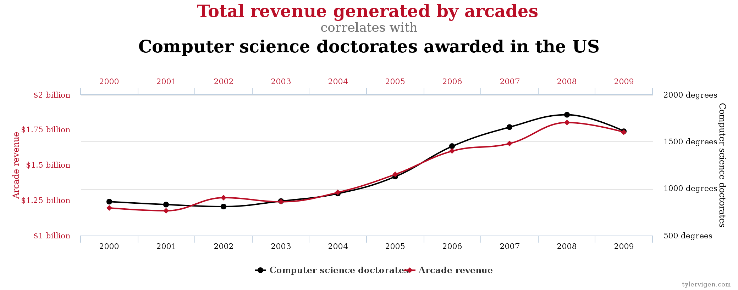
Causal inference is tricky Correlations are seldom enough. And sometimes horribly misleading. Always be skeptical of causal claims from observational any data. More data does not automatically lead to better causal estimates.
http://tylervigen.com/spurious-correlations

Slide 74
III. Hands-on tutorial

Slide 75
Code and resources available at
http://www.github.com/amit-sharma/causal-inference-tutorial
Contact: amshar@microsoft.com, @amt_shrma

Slide 76
Prerequisites
Need R, Rstudio.
Packages: dplyr, ggplot2
1. Install them using:
install.packages(“dplyr”)
install.packages(“ggplot2”)
2. Clone git repository
https://www.github.com/amit-sharma/causal-inference-tutorial

Slide 77
Gameplan
Study the effect of app store recommendation system.
Using system logs,
Compare two recommendation algorithms.
Estimate the causal effect of recommendations.

Slide 78
I. Which of the two algorithms is better?
Situation: Two Algorithms, A and B, were used to show app recommendations on the Store.
Data: System log data recording users’ visits.
Causal question: Which algorithm leads to higher click-through rates?

Slide 79
Loading user-app visits data
source(‘estimate_causal_effect.R')
user_app_visits_A = read.csv("user_app_visits_A.csv")

Slide 80
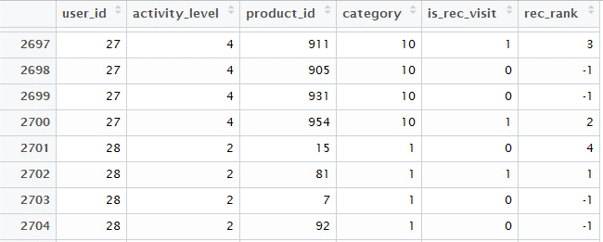
Dataset at a glance

Slide 81
Data description
user_id: Unique ID for user
activity_level: User’s activity level. Discrete (1:Lowest, 4:Highest)
product_id: Unique ID for an app
category: Category for an app (e.g. productivity, music, etc.)
is_rec_visit: Whether the app visit came through a recommendation click-through.
rec_rank: Rank in the recommendation list (only top-3 apps shown to user, -1 means that app was not in the recommendation list)

Slide 82
What’s in the dataset?
> nrow(user_app_visits_A)
[1] 1,000,000
> length(unique(user_app_visits_A$user_id))
[1] 10,000
> length(unique(user_app_visits_A$product_id))
[1] 990
> length(unique(user_app_visits_A$category)) [1] 10

Slide 83
Causal assumptions
We ask the system designers/look at the source code for the system.
Algorithm was selected based on activity level of users.
Further, CTR depends on
Activity level
Time of day
App category

Slide 84
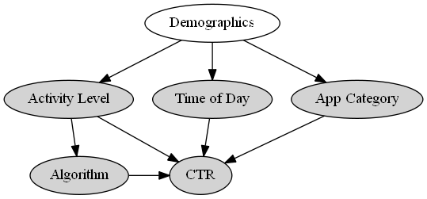
Graphical model to compare CTR of algorithms

Slide 85
Naïve estimate for comparing algorithms
> user_app_visits_B = read.csv("user_app_visits_B.csv")
> naive_observational_estimate <- function(user_visits){
# Naive observational estimate
# Simply the fraction of visits that resulted in a recommendation click-through.
est =
summarise(user_visits, naive_estimate=sum(is_rec_visit)/length(is_rec_visit))
return(est)
}
> naive_observational_estimate(user_app_visits_A)
naive_estimate
[1] 0.200768
> naive_observational_estimate(user_app_visits_B)
naive_estimate
[1] 0.226467

Slide 86
Using backdoor criterion, identify correct variables on condition on

Slide 87
Stratified estimate for comparing algorithms
> stratified_by_activity_estimate(user_app_visits_A)
Source: local data frame [4 x 2]
activity_level stratified_estimate
1 1 0.1248852
2 2 0.1750483
3 3 0.2266394
4 4 0.2763522
> stratified_by_activity_estimate(user_app_visits_B)
Source: local data frame [4 x 2]
activity_level stratified_estimate
1 1 0.1253469
2 2 0.1753933
3 3 0.2257211
4 4 0.2749867

Slide 88
If we had conditioned on category…
> stratified_by_category_estimate(user_app_visits_A)
Source: local data frame [10 x 2]
category stratified_estimate
1 1 0.1758294
2 2 0.2276829
3 3 0.2763157
4 4 0.1239860
5 5 0.1767163
… … …
> stratified_by_category_estimate(user_app_visits_B)
Source: local data frame [10 x 2]
category stratified_estimate
1 1 0.2002127
2 2 0.2517528
3 3 0.3021371
4 4 0.1503150
5 5 0.1999519
… … …

Slide 89
I. Which of the two algorithms is better?
The two Algorithms lead to roughly the same CTR.
Answer: Both are equally effective.
Still, the CTR estimate must be an over-estimate of the causal effect of recommendations, as people might have visited some of the apps anyways.
How to estimate the causal effect?

Slide 90
II. What is the causal effect of the recommendation system?
Situation: Two Algorithms, A and B, were used to show app recommendations on the Store.
Data: System logs containing user-app visits.
Causal question: How many apps would users have visited in case no recommendations were shown?

Slide 91
Graphical model to estimate causal effect
We observe total recommendation click-throughs.
But some of them may be due to correlated demand.

Slide 92
Using regression discontinuity analysis
We know that the Store only shows top-3 recommendations.
Comparing number of visits to the 4th ranked app (not shown to the user) with the 3rd ranked app can be used to estimate the effect of showing a recommendation.
(Assuming 3rd and 4th ranked apps are equally relevant to a user)

Slide 93
Discontinuity estimate for recommendations
> naive_observational_estimate(user_app_visits_A)
naive_estimate
[1] 0.200768
> ranking_discontinuity_estimate(user_app_visits_A)
discontinuity_estimate
[1] 0.121362
40% of app visits coming from recommendation click-throughs are not causal.
Could have happened even without the recommendation system.

Slide 94
Causal inference: Best practices
Whenever possible, use randomization.
If number of output items low, consider using multi-world testing.
If randomization is not feasible, consider exploiting natural experiments.
Better to consider multiple sources of natural experiments.
If natural experiments are hard to find, consider using conditioning methods.
Use them as strong hints for causality.

Slide 95
Thank you!
Amit Sharma
Postdoctoral Researcher, Microsoft Research
amshar@microsoft.com
@amt_shrma

